Slide 1


Multi-disciplinary Project Review
Smart Mirror Body Measurement System
SHAW N SHAIBU CHERIAN - 26BCE1820
NITHIN SANDESH S - 26BCE1821
AAKASH PON ALAGAPPAN - 26BCE5637
DHANARANJANI R - 26BEC1354
KAVYA S - 26BFT1001
Page 1

Slide 2
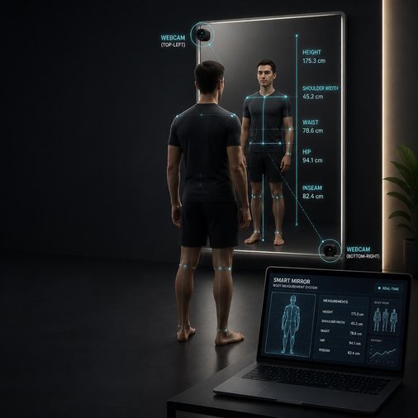
Goal
  Goal: Contact-free, instant body measurements with zero manual input
  Input: Two standard 1080p webcams
  Processing: Computer vision + AI-based pose estimation
  Output: Real-time body dimensions in centimeters
  Design principle: Low-cost, privacy-conscious, fully automated
The system transforms an ordinary mirror into a computer-vision-based measurement station.
Instead of using a measuring tape or expensive depth scanner, two cameras observe the user from different viewpoints. The software identifies body landmarks and combines information from both cameras to estimate dimensions such as:
  Shoulder width
  Arm length
  Waist width
  Hip width
  Inseam
  Overall height
Estimated chest/waist/hip circumference
The important idea is that the user does not have to enter height, weight, distance, or measurements manually.
Page 2

Slide 3
1. Size Uncertainty
Clothing sizes vary between brands, making it difficult for customers to select the correct size.
2. Manual Measurement
Traditional measurement requires:
  Measuring tape
  Staff assistance
  Multiple measurements
  Time
  Physical interaction
3. Expensive Scanning Technology
Professional body scanners require specialized sensors and infrastructure and can cost thousands of dollars.
Why Do We Need Automated Body Measurement?
Page 3

Slide 4
Comparison
Structure
Traditional | Smart Mirror
Manual | Automated
Contact-based | Contact-free
Expensive Scanner | Standard webcams
User Input | Minimal Input
Dedicated Equipment | Simple Kiosk
Public Kiosk
Installed on the open retail floor, allowing users to remain fully clothed.
Zero Manual Input
The system automatically determines:
  User position
  Camera distance
  Body landmarks
  Pixel-to-real-world scale
  Body dimensions
Privacy by Design
Camera → RAM → Processing → Measurements → Frame discarded
The prototype is designed for real-time processing without persistent video storage.
Low-Cost Hardware
2 webcams + mirror + laptop
Approximately:
$110 / ₹9,100
A Low-Cost, Contact-Free Measurement Kiosk
Page 4

Slide 5
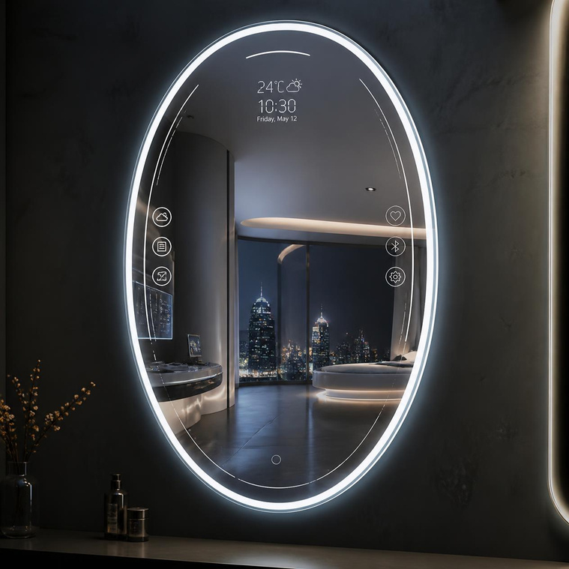
Mirror
180 cm × 60 cm standard glass mirror
Top-Left Camera
Height: 1.6 m
Captures:
  Head
  Shoulders
  Arms
  Upper body
Tilted slightly downward and inward.
Bottom-Right Camera
Height: 0.85 m
Captures:
  Waist
  Hips
  Legs
  Feet
  Heel position
Tilted slightly upward and inward.
User Distance
1.3–1.5 m
Simple Hardware, Carefully Positioned
Page 5

Slide 6

How the Technology Works
Pipeline
Dual Cameras
↓
Video Frames
↓
MediaPipe Pose
↓
33 Body Landmarks
↓
Calibration + Scale
↓
Measurement Engine
↓
Body Measurements
Auto Scaling:
The bottom camera observes the user's feet/heel position.
Using the camera's known geometry and the heel's position, the system estimates:
Z = camera-to-user distance
This allows conversion between:
pixels → centimeters
without requiring the user to enter their distance manually.
Page 6

Slide 7
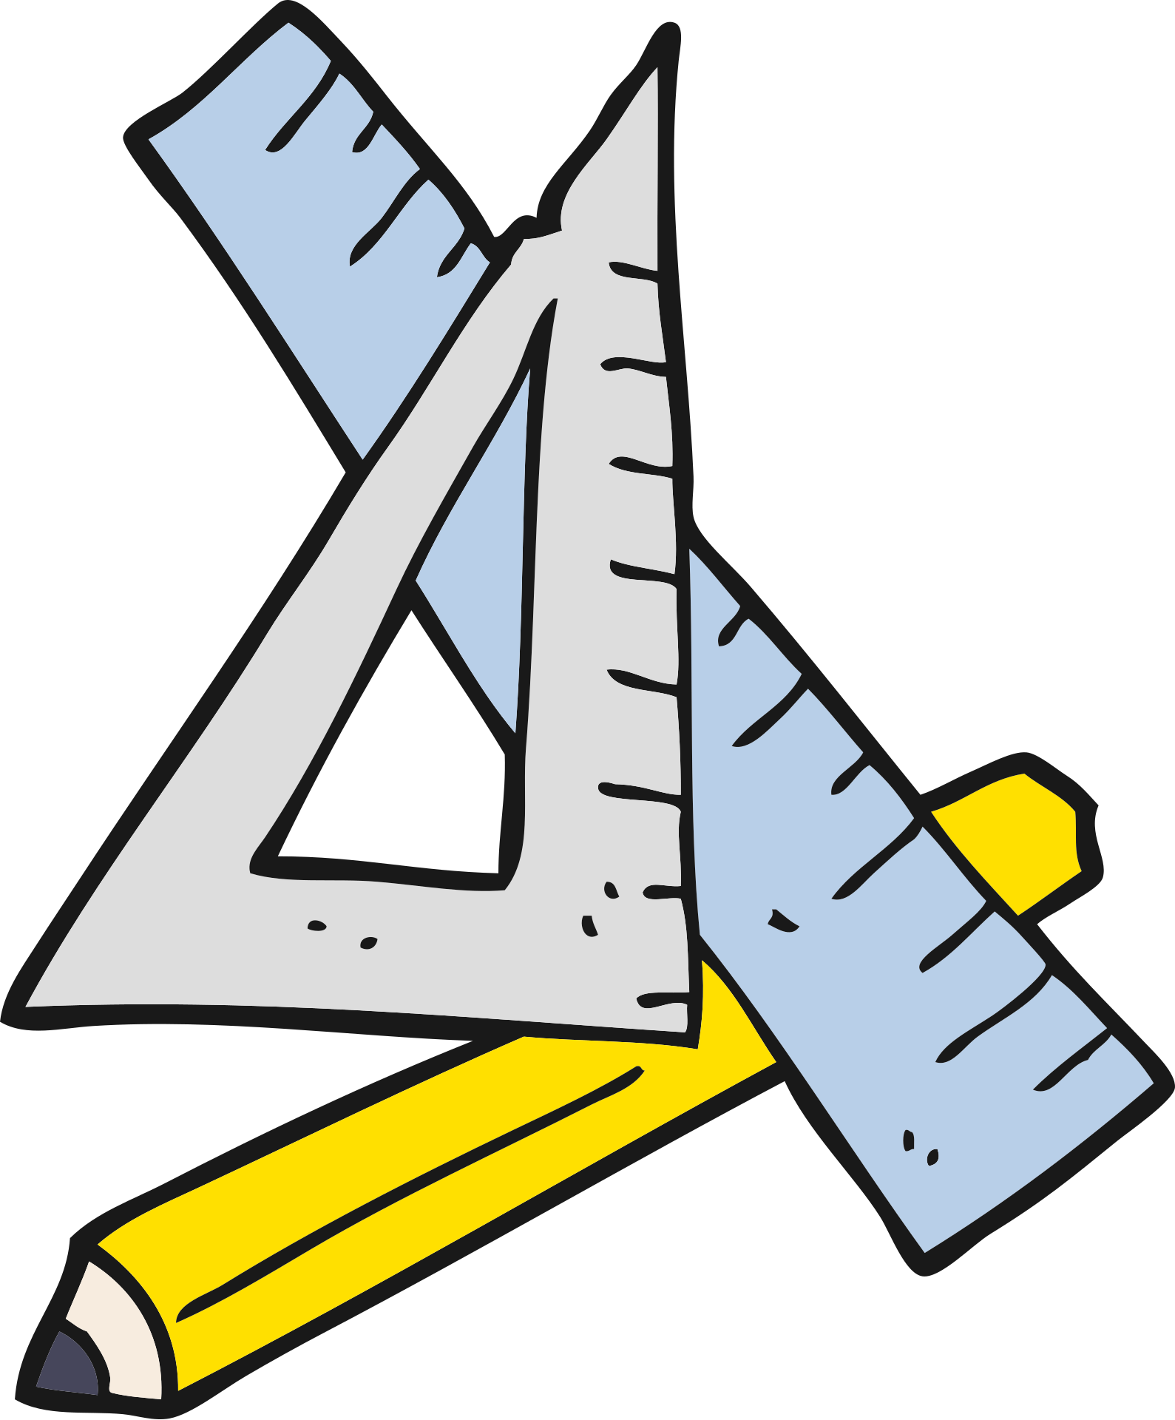
MediaPipe Pose provides 33 body landmarks, including:
  Nose
  Shoulders
  Elbows
  Wrists
  Hips
  Knees
  Ankles
  Heels
  Feet
The Measurement Math
For point-to-point measurements:
D=(x2−x1)2+(y2−y1)2+(z2−z1)2D=\sqrt{(x2-x1)^2+(y2-y1)^2+(z2-z1)^2}
Used for measurements such as:
  Shoulder width
  Arm length
  Inseam
For circumferences, estimate body depth and approximate the cross-section as an ellipse.
.
Page 7

Slide 8

Tech Stack
Backend
Python
Controls the complete processing pipeline.
OpenCV
  Video capture
  Frame processing
  Calibration
  Image transformations
MediaPipe
  Pose detection
  Landmark extraction
  Body tracking
FastAPI + WebSocket
Provides continuous communication between the measurement engine and frontend.
Frontend
Dark-mode dashboard displaying live measurements in centimeters.
Performance
Target: ~30 FPS
Webcams
↓
OpenCV
↓
MediaPipe
↓
Measurement Engine
↓
FastAPI
↓
WebSocket
↓
Web Dashboard
Page 8

Slide 9
Applications and next steps
3. Improved Calibration
Future versions can improve:
  Perspective correction
  Camera calibration
  User positioning
  Measurement accuracy
4. Advanced Body Geometry
Potential future improvements:
  Additional camera viewpoints
  Better depth estimation
  More sophisticated body models
  ML-based measurement correction
1. Brand-Specific Sizing
Current:
Waist = 84 cm
Future:
Brand A → M
Brand B → L
Brand C → 32
2. QR Code Export
Measurement → QR Code → Smartphone
Users can save their measurements without manually typing them.
Page 9

Slide 10
Page 10

